Slide 1
ECEN 192 Lab 5
Motors, Actuators, and Sensors
Intro 1

Slide 2
Motors and Actuators
How a circuit affect the rest of the world
Intro 2

Slide 3
Controls and Sensors
Respond to outside stimulus
Intro 3

Slide 4
In this lab we will…
Identify a problem
Design a system to solve the problem
Build the circuit and test its effectiveness
Intro 4

Slide 5
Our Problem
Your desk gets hot when the sun shines on it through the window
Intro 5

Slide 6
Idea: Build a light sensitive fan
Design goals:
Manual on/off switch
Variable fan speed
Respond to our setting and to the ambient light in the room
Intro 6

Slide 7
What’s Available in the Shop?
Power Source:
9V battery
Actuator:
Motor w/ convenient fan blades
Control
Switches
Potentiometer
Sensor
Photoresistor
Research 1

Slide 8
Battery Specifications (specs)
https://cdn.allmaxbattery.com/wp-content/uploads/2022/05/18202007/Specs-for-9V-6LR61.pdf
From datasheet:
Nominal Voltage 9 volt
Nominal Capacity 690 mAh (milliampere-hours)
Discharges over 10 hours ~ 50mA
Should be able to drive our motor for many hours (possibly up to a weeks worth of study sessions)
Research 2

Slide 9
Motor Specs
Threshold Voltage: 1V
Maximum Voltage: 6V
(likely can handle 9V for short periods of time with no issue)
Internal Resistance: ~3 Ohms
No-load speed: Motor details in Appendix A
3V: 7900 RPM (23mA)
6V: 15500 RPM (36mA)
Research 3

Slide 10
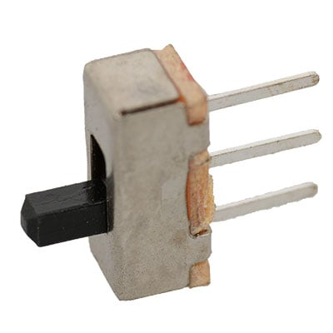
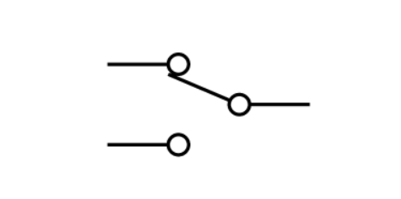

Switches Details
Middle pin is common, and can only connect to one side or the other depending on switch position
Research 4

Slide 11
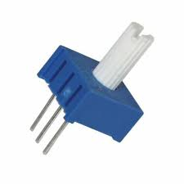
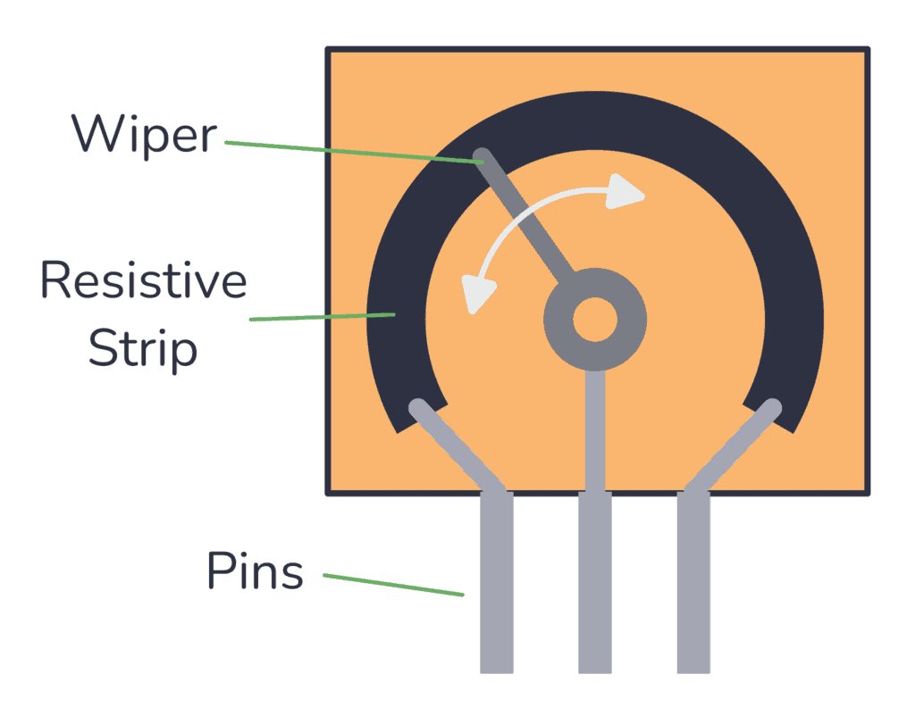
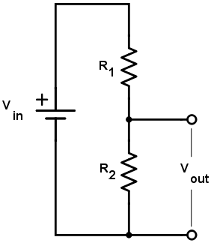
Potentiometer Details
Used as a manual variable resistor in our circuit
Our value will be 1 Kohm
Research 5

Slide 12


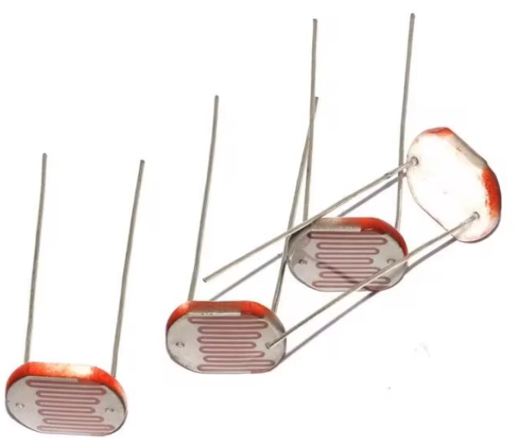
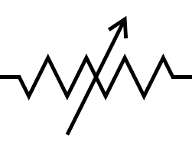

Sensor – Photoresistor Specs
Used as a passive variable resistor in our circuit
Photoresistor details in Appendix B
~20 Kohm
~100 ohm
~2 Kohm
Research 6

Slide 13
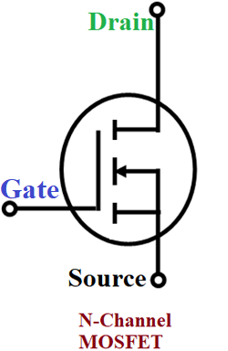
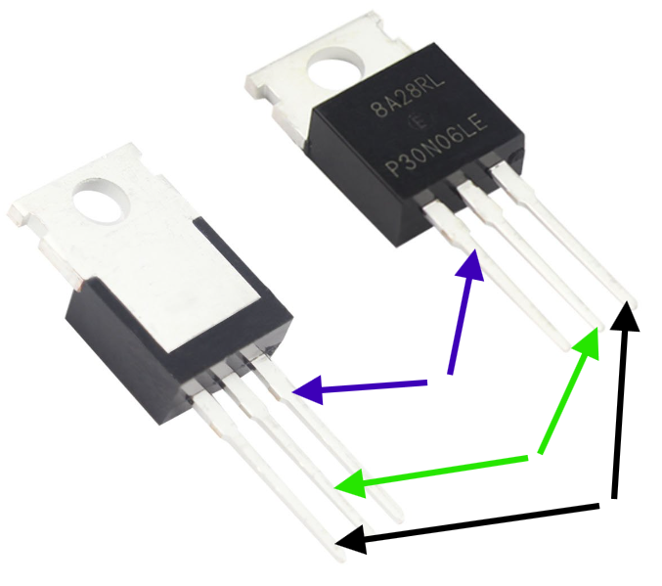
Transistor – Motor Driver
Transistors are easier to control than motors, so we will use this with our photoresistor to allow more precise motor control
Gate (left pin): node whose voltage controls if the MOSFET allows current or not
Drain (middle pin): where the electrons flow to or “drain” to
Source (right pin): “source” of electrons
Research 7

Slide 14
More Details in Appendix
Appendix contains additional information relevant to this circuit that is beyond the scope of this lab. It is an optional resource for those who are interested.
Details included
A: Motor function explanation
B: Advanced photoresistor specifications
C: Details on transistor we use for final circuit
Research 8

Slide 15
Implement the Switch
Build the simple switch circuit on the following slide
Test the functionality by moving the switch back and forth
Pro Tip:
Tape your battery connection into the breadboard; it comes out easily.
Tape your motor fan to the edge of a desk so it can operate safely.
Design & Build 1

Slide 16
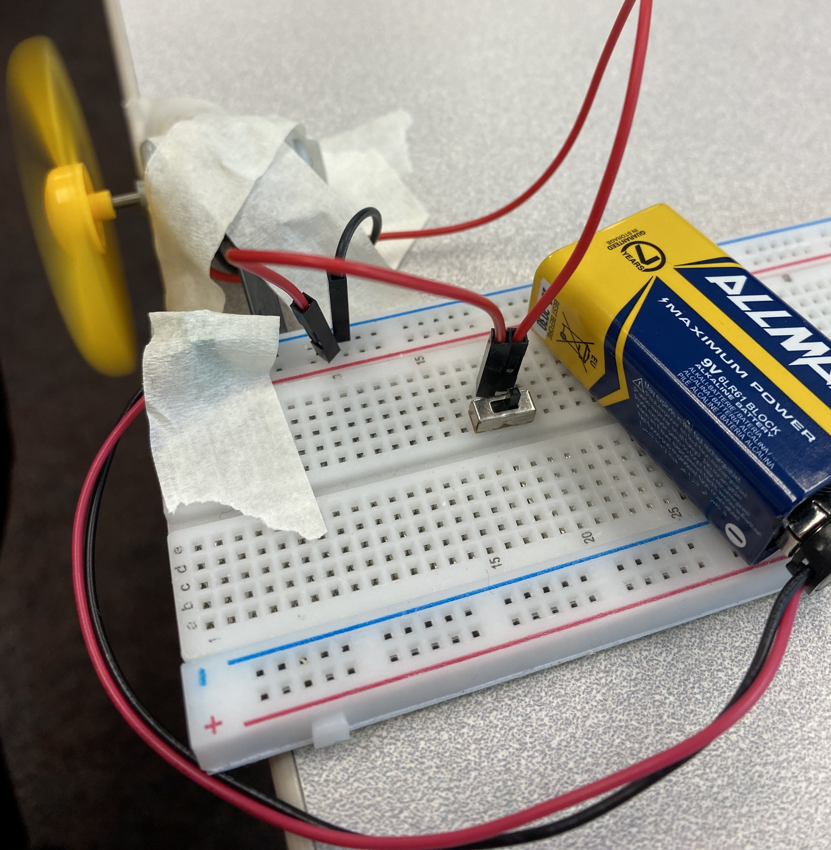
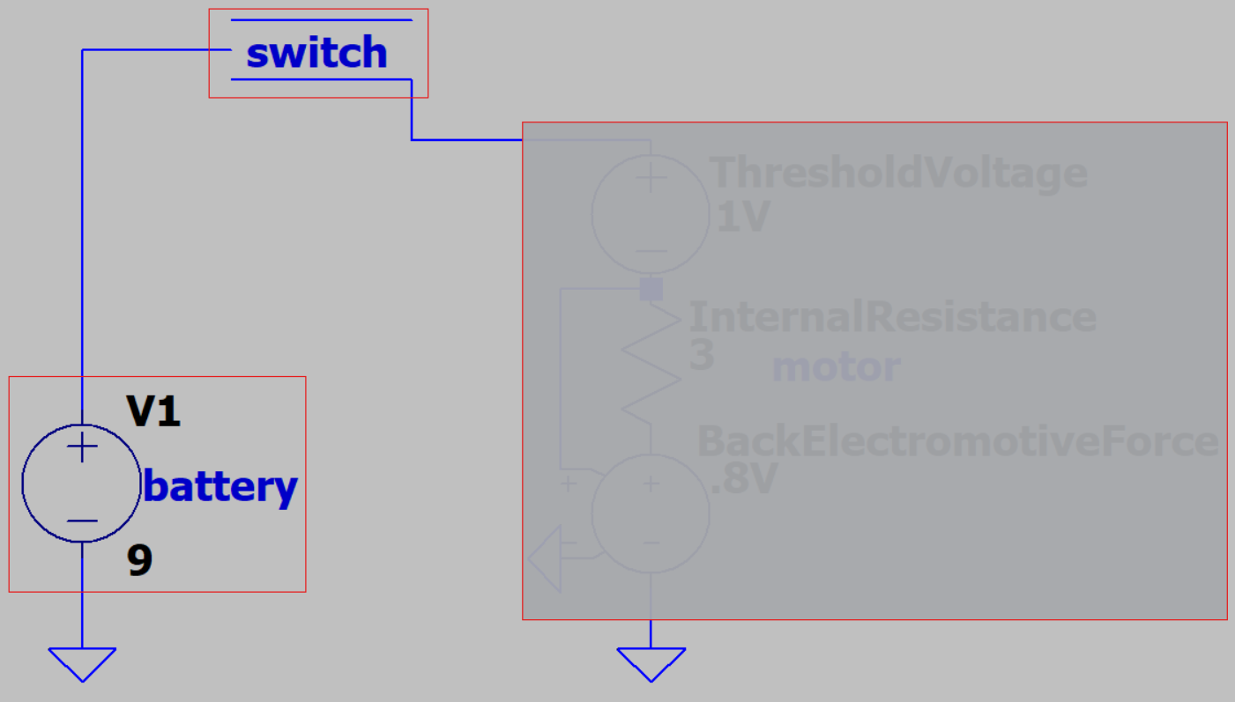
Switch Circuit Diagram
Red boxes are components
Use jumper wires for connections
Motor goes here:
Simulation details
in Appendix A
Design & Build 2

Slide 17
Implement the Potentiometer
Build the simple potentiometer circuit on the following slide
Test the functionality by slowly sweeping (twisting) the potentiometer with the switch in the on position
Design & Build 3

Slide 18
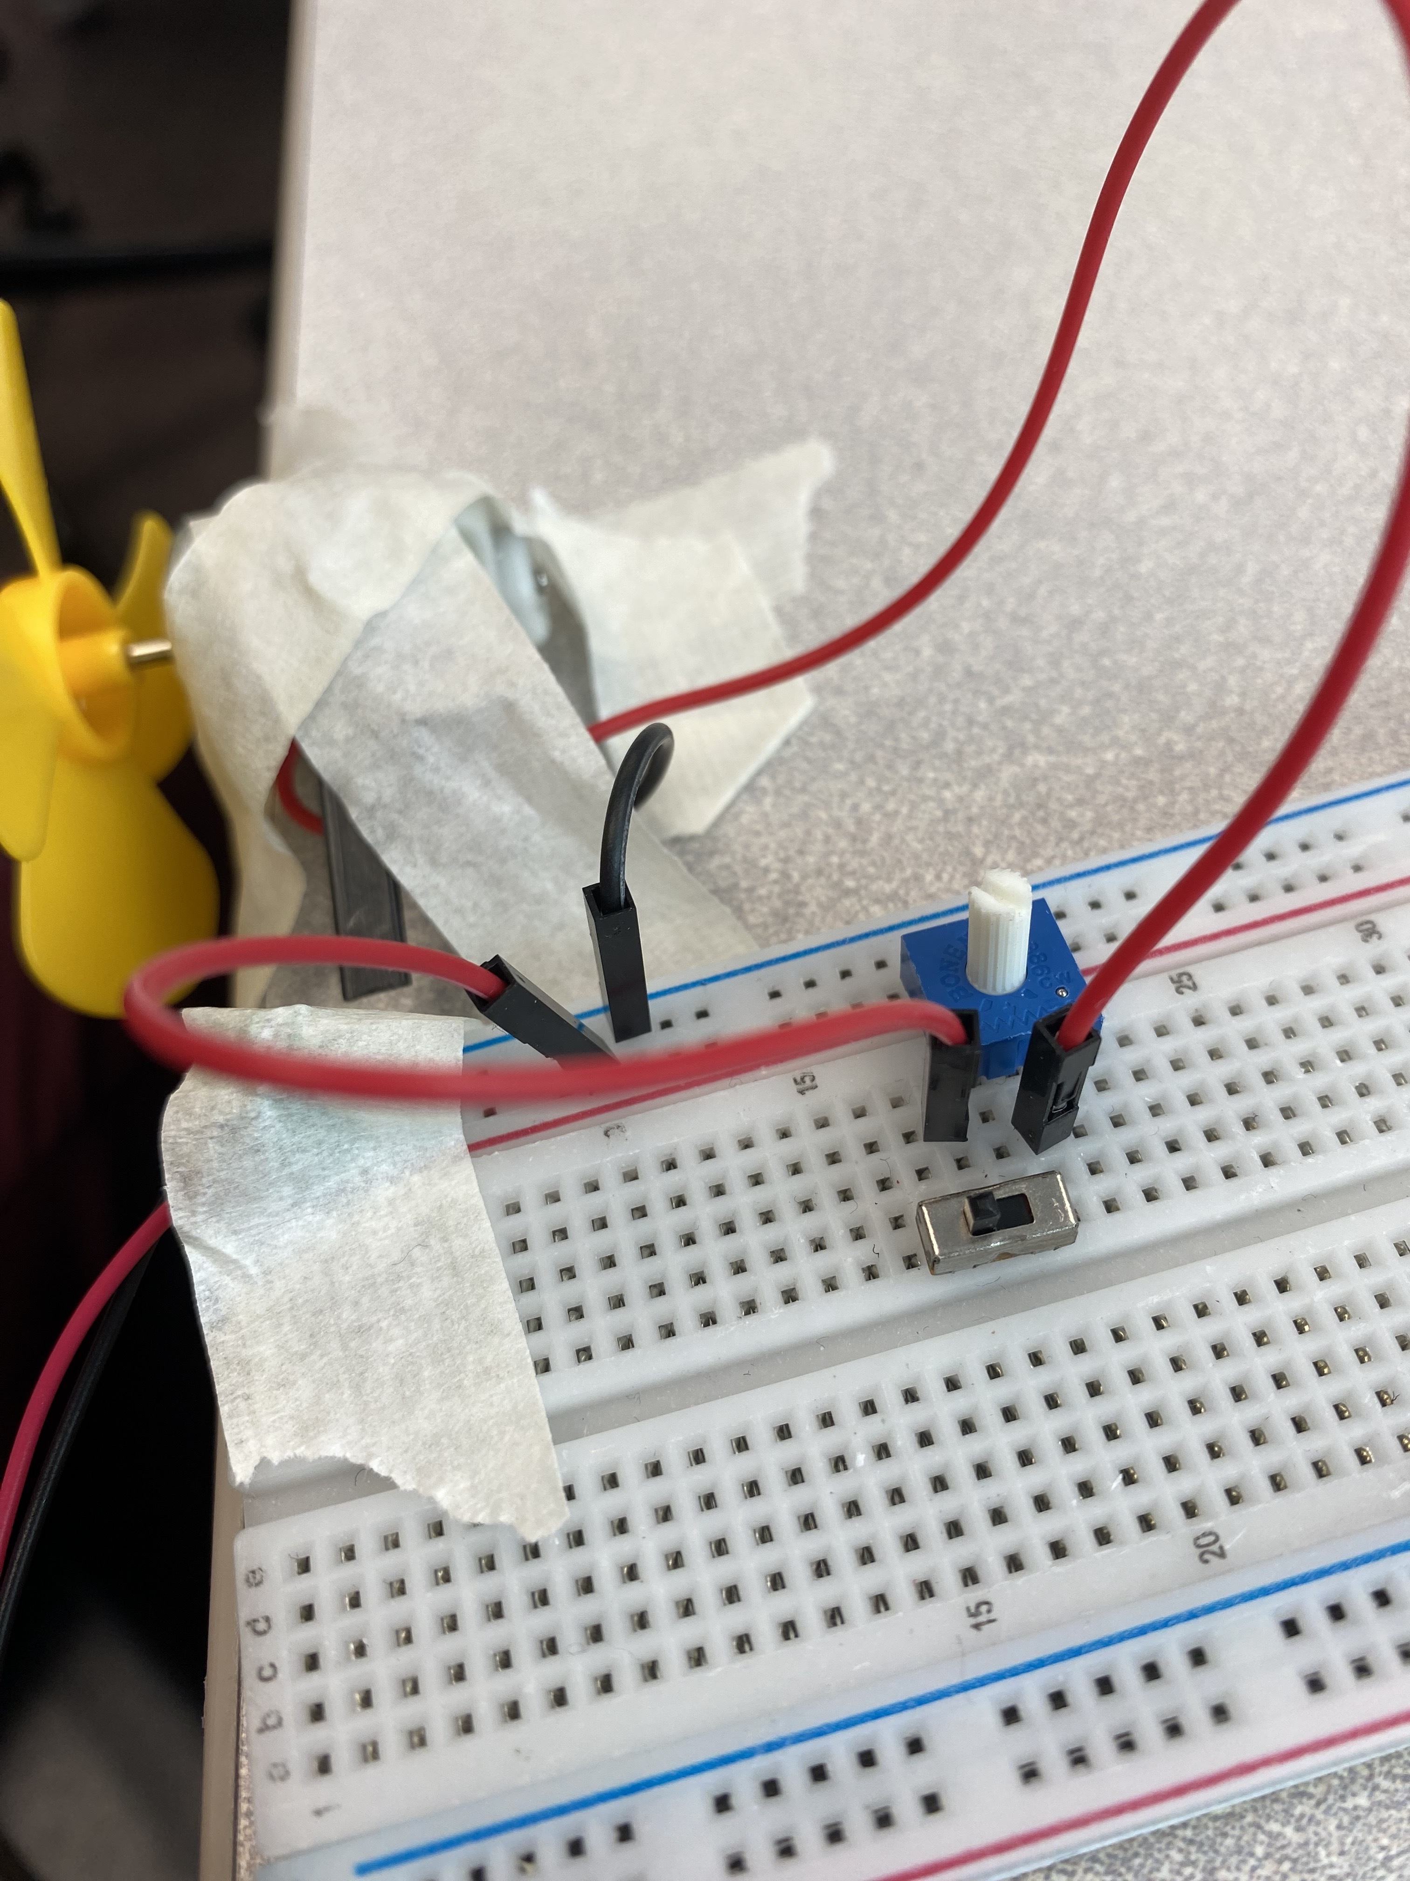
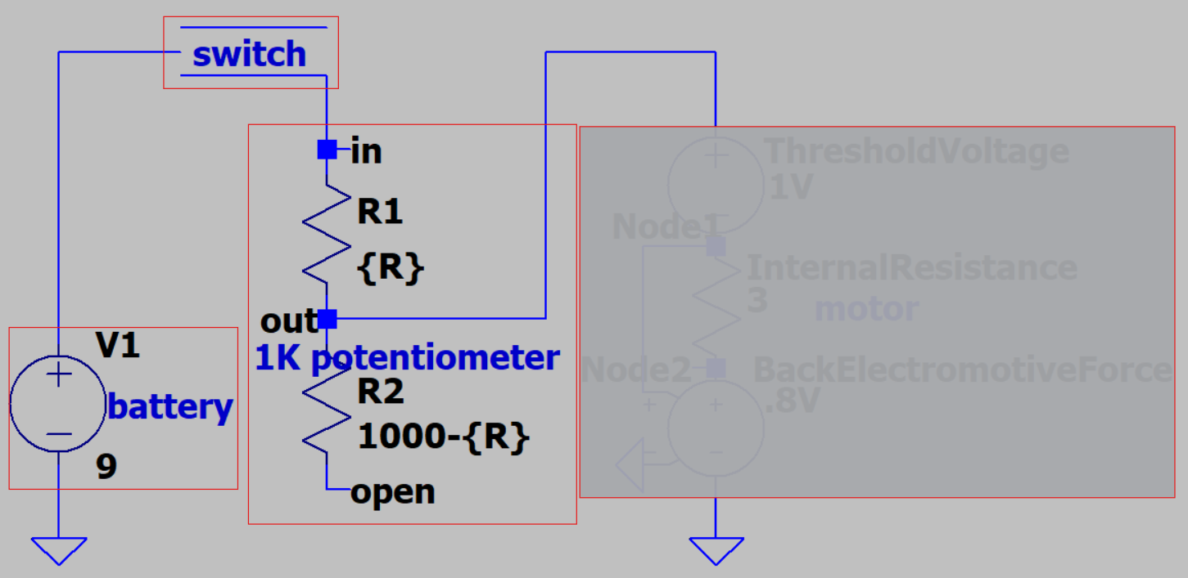
Pot. Circuit Diagram
Same circuit as before but wired through one half of our potentiometer
Motor goes here:
Simulation details
in Appendix A
Design & Build 4

Slide 19
Implement the Photoresistor (Sensor)
Again, build the circuit shown on the following slide.
Test the functionality of the circuit by covering the photoresistor with your finger to turn the motor on.
While the configuration shown will turn on the motor in the dark for testing purposes in a bright room, simply flipping the voltage divider will cause the fan to turn on/speed up in brighter light as outlined in our project goals. The lab configuration was chosen with ease of testing in mind.
Design & Build 5

Slide 20
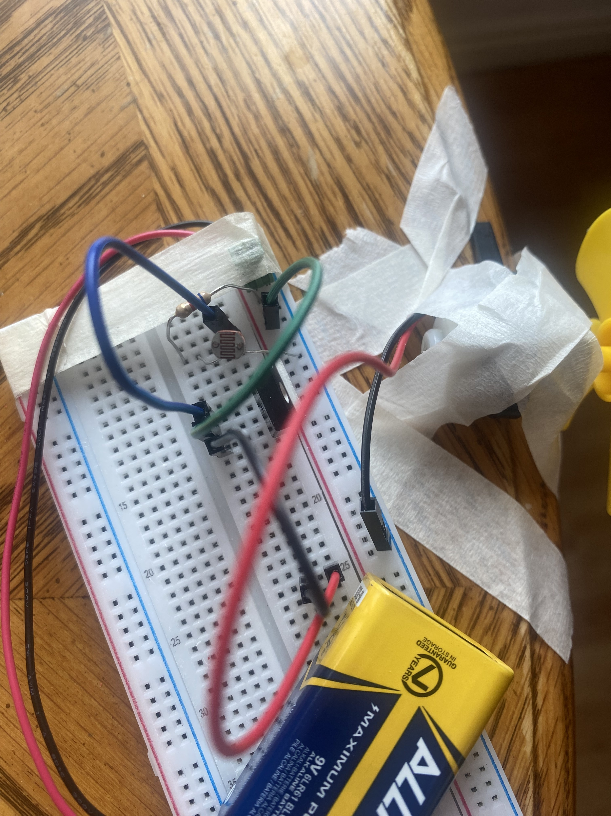
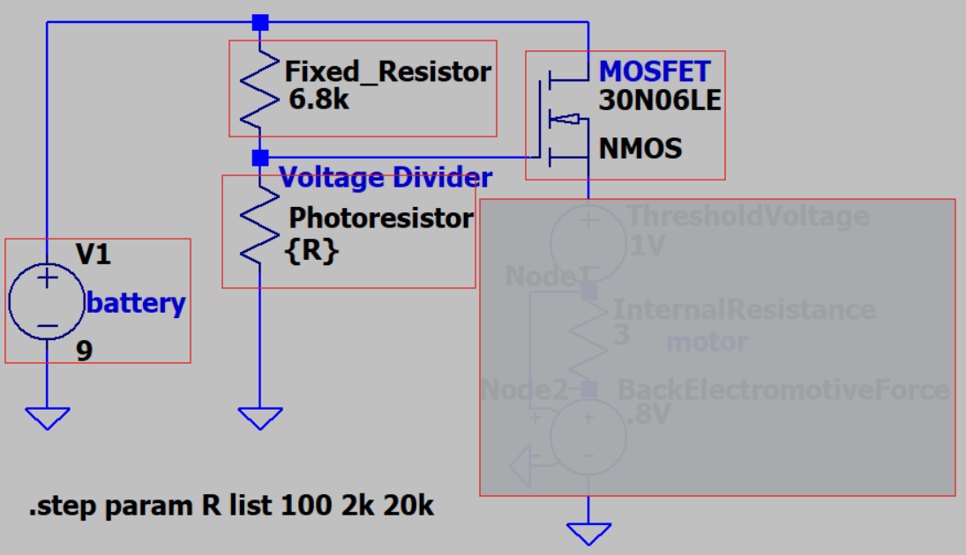
Photoresistor Circuit Diagram
Remove the switch and pot.
Build the following circuit
Be careful about the connections and pay attention to the color code since the schematic has a different pin order than the actual chip
Motor goes here:
Simulation details
in Appendix A
Design & Build 6

Slide 21
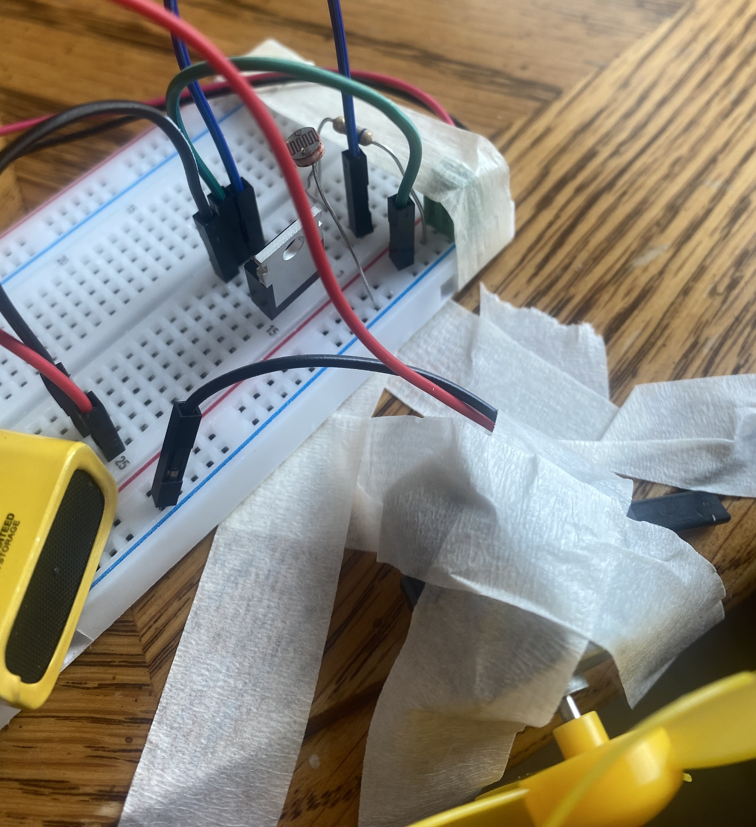
Photoresistor Circuit Alternative View
The circuit is the same one shown on the previous slide, just from a different perspective.
Note: the blue, green, and black jumper wires to the MOSFET are consistent with the color coding from the schematic.

Slide 22
END OF LAB
Congratulations, you have completed Lab 5!
With lab outlined a solid approach to identifying and solving a problem, which approach should be useful in future situations.
Continued after this slide is additional, optional info on specific components used in this lab.
Conclusion

Slide 23
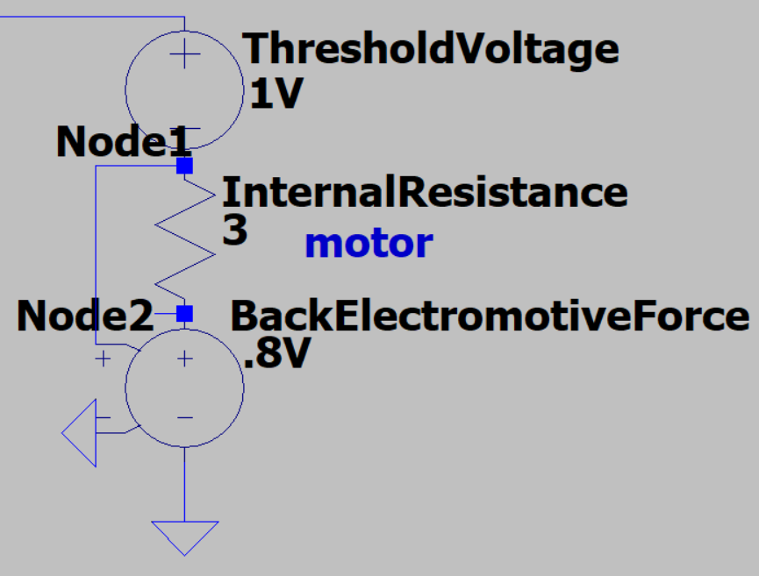
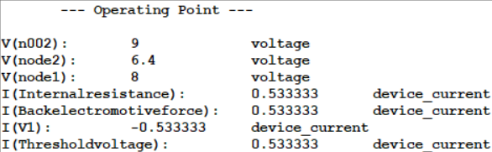
Appendix A – Motor Function
Back EMF stands for back electromotive force, which is a result of the motor translating electrical power to rotational motion. It is measured in volts and can be modeled as a fraction of the applied voltage across the motor (voltage*0.8).
Once the threshold voltage is reached, the motor dissipates power through motion (Back EMF) and kinetic friction (Internal Resistance). The low internal resistance (3 ohms) and high ratio for back EMF suggests an efficient motor.
One drawback of the low internal resistance is that the motor does not function well in series with other resistive elements (hence the need of our amplifier in the last circuit)
According to our simulation in LTspice (software you will become familiar with), our design simple switch design drops 1 volt to overcome static friction (threshold voltage) 1.6 volts to internal resistance (volts of node1- volts of node2), and 6.4 volts to rotational motion.
Appendix A

Slide 24
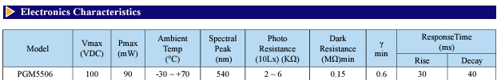
Appendix B – Photoresistor Response
https://www.tme.eu/Document/0b7aec6d26675b47f9e54d893cd4521b/PGM5506.pdf
The light dependent resistor (LDR or photoresistor) we use has a nonlinear response to light. The datasheet gives data for 10 Lux, whereas the rooms we usually are in are ~20 Lux. The values given in the lab specs are experimental values measured in realistic conditions during lab development.
Appendix B

Slide 25
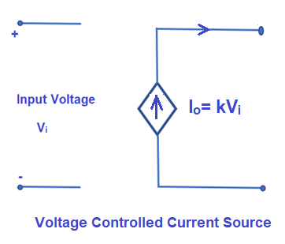
Appendix C – Simple MOSFET Explanation
https://www.mouser.com/datasheet/2/308/rfp30n06le-1195941.pdf
While the above datasheet is the official one, the most relevant way to describe this is the explain a voltage controlled current source.
Since our motor has low internal resistance, we need the component in series with it to go to zero resistance, which allows us to get the greatest voltage across our motor (and thus higher back EMF). MOSFETs, such as the 30n06le, are the easiest way to accomplish this.
With this configuration we can turn our motor on with a parallel voltage divider that changes with light (due to our LDR) and have current flow freely through the motor. This does mean the potentiometer setup is not optimal, but hey, it’s a beginner circuit. You will get to know MOSFETs very well junior year.
Appendix C

